Slide 1


K.RAMAKRISHNAN COLLEGE OF TECHNOLOGY (AUTONOMOUS), TRICHY
REAL-TIME VISUALIZATION OF CRICKET SCORES USING SHINY
PRESENTED BY
VAISHALI A
2303811724322118

Slide 2
PRESENTATION OVERVIEW
Problem Identification
Objective
Block Diagram
Module Used
Module Description
Coding Implementation
Conclusion

Slide 3
PROBLEM IDENTIFICATION
Data Acquisition: Fetching Live Cricket Scores
Data Sources: Live cricket data is not always freely available. Reliable sources include cricket API providers such as CricAPI, ESPN CricInfo, or web scraping from live score websites.
2. Real-Time Updates: Dynamic Score Display
Frequent Data Refreshing: Cricket scores change every few seconds, requiring the application to fetch and display updates seamlessly.
Concurrency Issues: Handling multiple simultaneous users fetching live data can overload the server.
3. Interactive Visualization
User-Friendly Interface: The dashboard should be easy to navigate, with clear visualization of match data.

Slide 4
OBJECTIVE
Real-Time Data Acquisition
Integrate with Live Cricket APIs (such as CricAPI, ESPNCricInfo, or SportsRadar) to fetch up-to-the-second match scores, player statistics, and team performances.
Implement Web Scraping (if APIs are unavailable) using rvest or RSelenium to extract live match details from cricket websites dynamically.
2. Dynamic Score Visualization
Present Live Match Scores in tabular and graphical formats to display essential match details such as:
Runs scored
Wickets fallen
Overs bowled
Current run rate
Required run rate (for chases)

Slide 5
PROPOSED SYSTEM
BLOCK DIAGRAM
User Interface (Shiny)
Dashboard Layout
Interactive Charts
Score Filters & Tabs
Backend Processing
Reactive Data Handling
API/Web Scraping
Data Transformation
Data Storage & Caching
SQL/NoSQL Databases
Reactive Polling
Win Probability Models
Caching & Optimization
Reduce API Calls
Edge Computing
Live Data Acquisition
API Calls
Web Scraping
Weather & Pitch Data
API Rate LimitHandling
Cloud Deployment
ShinyApps.io / AWS
Performance Tuning
Multi-User Scaling

Slide 6
MACHINE LEARNING USED
Linear Regression: Predicting final score
Random Forest : Score prediction, player stats, win probability
Gradient Boosting (XGBoost) : Real-time win probability, classification, regression
Logistic Regression: Win prediction

Slide 7
ADVANTAGES OF PROPOSED SYSTEM
1. Advanced Analytics & Predictive Insights
Win Probability Estimations: Uses machine learning models to predict match outcomes dynamically.
Projected Scores & Trends: Analyzes potential match outcomes based on historical and live data.
2. Live Score Fetching:
No Manual Refresh Needed: Uses invalidateLater() to refresh data dynamically.
Ball-by-Ball Updates: Provides instant updates on runs, wickets, strike rates, partnerships, and match events.
3. Web-Based Application:
Cross-Platform Availability: Works on Windows, macOS, and Linux without requiring complex installations.
Scalability for Large Audiences: Can efficiently handle multiple users accessing live scores simultaneously.

Slide 8


MODULES
Data Input Module
Machine Learning Model Module
Real-Time Prediction Module
Shiny User Interface (UI) Module
Visualization & Graph Module

Slide 9
MODULE DESCRIPTION
Data Input Module Simulates or fetches real-time cricket score data (overs, runs, wickets, run rate) to be used for analysis and prediction. Machine Learning Model Module Trains a predictive model (e.g., Linear Regression, Random Forest) on historical/simulated data to forecast final scores or match outcomes. Real-Time Prediction Module Uses current match data as input to the trained ML model to generate predictions (like final score or win probability) dynamically.

Slide 10

MODULE DESCRIPTION
Shiny User Interface (UI) Module
Displays interactive elements like refresh buttons, current scores, predicted results, and charts. Handles all user interactions.
Visualization & Graph Module
Uses ggplot2 (or plotly) to show live score trends, predicted final scores, and other insights in real-time graphs.

Slide 11
SOURCE CODE
mainPanel(
plotOutput("score_plot")
)
)
)
# Server
server <- function(input, output, session) {
# Reactive value to store the latest data
live_data <- reactiveVal(generate_score())
# Refresh every 5 seconds
autoInvalidate <- reactiveTimer(5000)
observe({
autoInvalidate()
live_data(generate_score())
})
observeEvent(input$refresh, {
live_data(generate_score())
})
library(shiny)
library(ggplot2)
library(dplyr)
# Simulated Live Data Generator
generate_score <- function() {
over <- 1:20
runs <- cumsum(sample(1:10, 20, replace = TRUE))
wickets <- cumsum(sample(c(0, 0, 1), 20, replace = TRUE)) # Simulate few wickets
run_rate <- runs / over
data.frame(over, runs, wickets, run_rate)
}
# UI
ui <- fluidPage(
titlePanel("Real-Time Cricket Score Prediction using ML"),
sidebarLayout(
sidebarPanel(
actionButton("refresh", "Refresh Data"),
textOutput("prediction_text")
),
)

Slide 12
SOURCE CODE
output$prediction_text <- renderText({
df <- live_data()
latest <- tail(df, 1)
newdata <- data.frame(
over = latest$over,
wickets = latest$wickets,
run_rate = latest$run_rate
)
pred <- predict(model, newdata)
paste("📊Predicted Final Score:", round(pred))
})
# Plot current scores
output$score_plot <- renderPlot({
df <- live_data()
ggplot(df, aes(x = over, y = runs)) +
geom_line(color = "darkblue", size = 1.5) +
geom_point(color = "orange", size = 3) +
labs(title = "Live Match Score", x = "Overs", y = "Total Runs") +
theme_minimal()
})
}
shinyApp(ui, server)

Slide 13
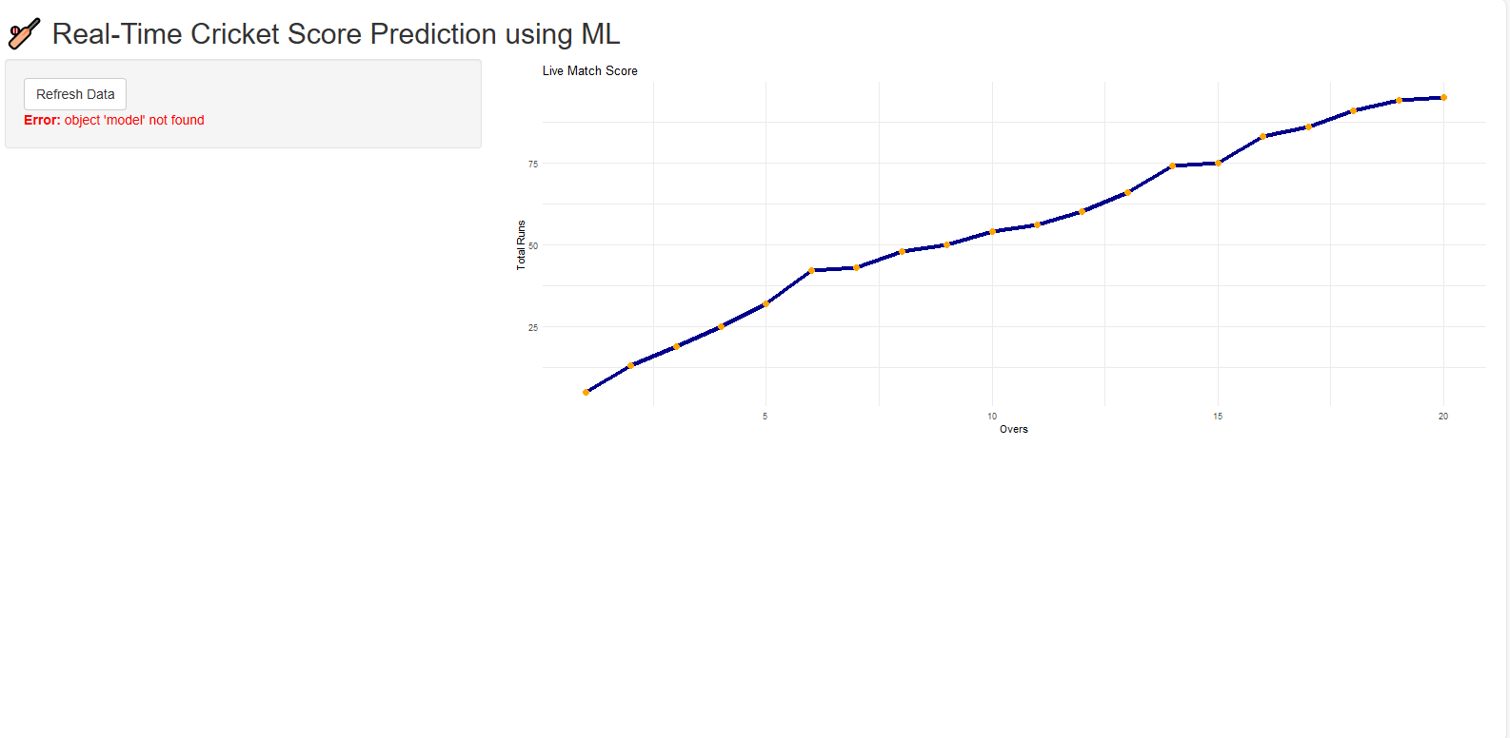
OUTPUT

Slide 14
CONCLUSION
R programming, machine learning, and Shiny web applications can be used to build a powerful, real-time dashboard for cricket score visualization and prediction. By simulating or fetching live match data, training predictive models like Linear Regression or Random Forest, and deploying it through an interactive Shiny interface, we enable users to not only monitor the match progress but also gain insightful forecasts such as the predicted final score or win probability. The project showcases how R and Shiny can go beyond static analysis to provide real-time, interactive, and intelligent sports insights, making cricket data both engaging and actionable.

Slide 15


